Slide 1


Analysis of and Mitigation Strategies for Real World ICS Security Incidents
Nico Fechtner
nico.fechtner@tum.de
June 4, 2020
Notes:
Notes

Slide 2
[Motivation]
Maybe a nice graph or picture
2

Slide 3
Problem Statement
Develop detection and mitigation strategies
Avoid known/common mistakes
Learn from past incidents
Comparative overview of historic incidents
+
In-depth analyses of individual incidents
3
Notes:
Animate last point bold

Slide 4
Agenda
Motivation & Problem Statement
Comparative Overview of ICS Security Incidents
Case Study: The Triton Attack
Conclusion & Future Work
4

Slide 5
Agenda
Motivation & Problem Statement
Comparative Overview of ICS Security Incidents
Case Study: The Triton Attack
Conclusion & Future Work
5

Slide 6
Analyzed Incidents
Comparative Overview of ICS Security Incidents
Incident enumerations (Risi database, ICS-CERT alerts)
Threat reports from ICS security companies
Papers / conference talks dedicated to single incidents
Press releases / blog posts dedicated to single incidents
27 incidents analyzed
6

Slide 7
Targets
Comparative Overview of ICS Security Incidents
7

Slide 8
Targets
Comparative Overview of ICS Security Incidents
8

Slide 9
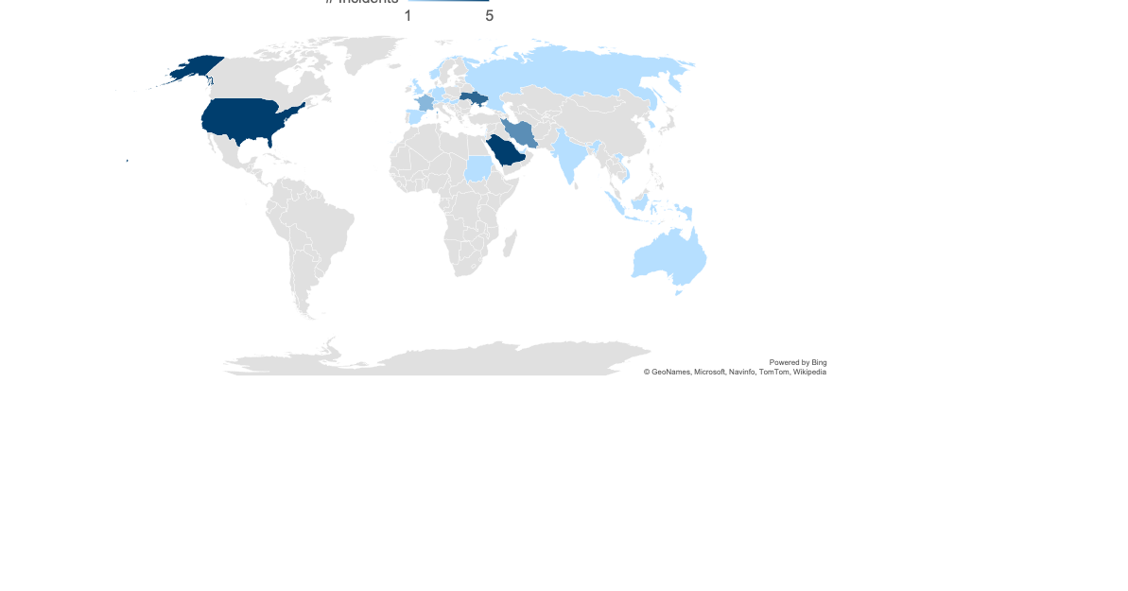
Targets
Comparative Overview of ICS Security Incidents
9
Notes:
Entities in Europe are targeted by about 37%
Middle East is being targeted by about 33%
19% of the analyzed incidents, the US were amongst the victims
neither Russia nor China nor North Korea report a lot of ICS incidents against entities located in their countries

Slide 10
Threat Actors
Comparative Overview of ICS Security Incidents
10
Notes:
Animate last point bold

Slide 11
Attack Techniques
Comparative Overview of ICS Security Incidents
11
Notes:
Animate last point bold

Slide 12
Attack Goals and Realized Impacts
Comparative Overview of ICS Security Incidents
12
Notes:
Animate last point bold

Slide 13
Dwell Times and Reactions
Comparative Overview of ICS Security Incidents
13
Notes:
Animate last point bold

Slide 14
Detection and Mitigation Strategies
Comparative Overview of ICS Security Incidents
14
Notes:
Animate last point bold

Slide 15
Agenda
Motivation & Problem Statement
Comparative Overview of ICS Security Incidents
Case Study: The Triton Attack
Conclusion & Future Work
15

Slide 16
Safety Instrumented Systems (SIS)
Case Study: The Triton Attack
16
Notes:
Animate last point bold

Slide 17
Attack and Response Strategies
Case Study: The Triton Attack
17
Notes:
Animate last point bold

Slide 18
Goals, Impacts, and Attribution
Case Study: The Triton Attack
18
Notes:
Animate last point bold

Slide 19
Detection and Mitigation Opportunities
Case Study: The Triton Attack
19
Notes:
Animate last point bold

Slide 20
Agenda
Motivation & Problem Statement
Comparative Overview of ICS Security Incidents
Case Study: The Triton Attack
Conclusion & Future Work
20

Slide 21
Conclusion
Untargetted attacks are becoming increasingly important
Most attacks are considered to be state-sponsored
Important trends in terms of attack techniques are spearphishing, zero-day exploits, sophisticated obfuscation and evasion techniques, and living off the land tools
The most common goals of ICS attacks are data extraction and causing disruption
Attackers usually reside in the victims’ network for several weeks or months before executing the final payload
increasing the security awareness of employees, strictly separating the ICS net- work from the enterprise IT network, and establishing a reliable backup strategy
21

Slide 22
Future Work
Analyze more incidents
Analyze incidents in more depth -> Marisol
Analyze how ICS companies manage to defend against known threats over the course of time
22

Slide 23
Q & A
23

Slide 24
Backup
24

Slide 25
Analyzed Incidents
Comparative Overview of ICS Security Incidents
25
Notes:
Animate last point bold

Slide 26
Comparative Overview of ICS Security Incidents
Targets
Threat actors
Attack techniques
Attack goals and realized impacts
Dwell times and reactions
Detection and mitigation strategies
26
Notes:
Evtl. rausnehmen

Slide 27
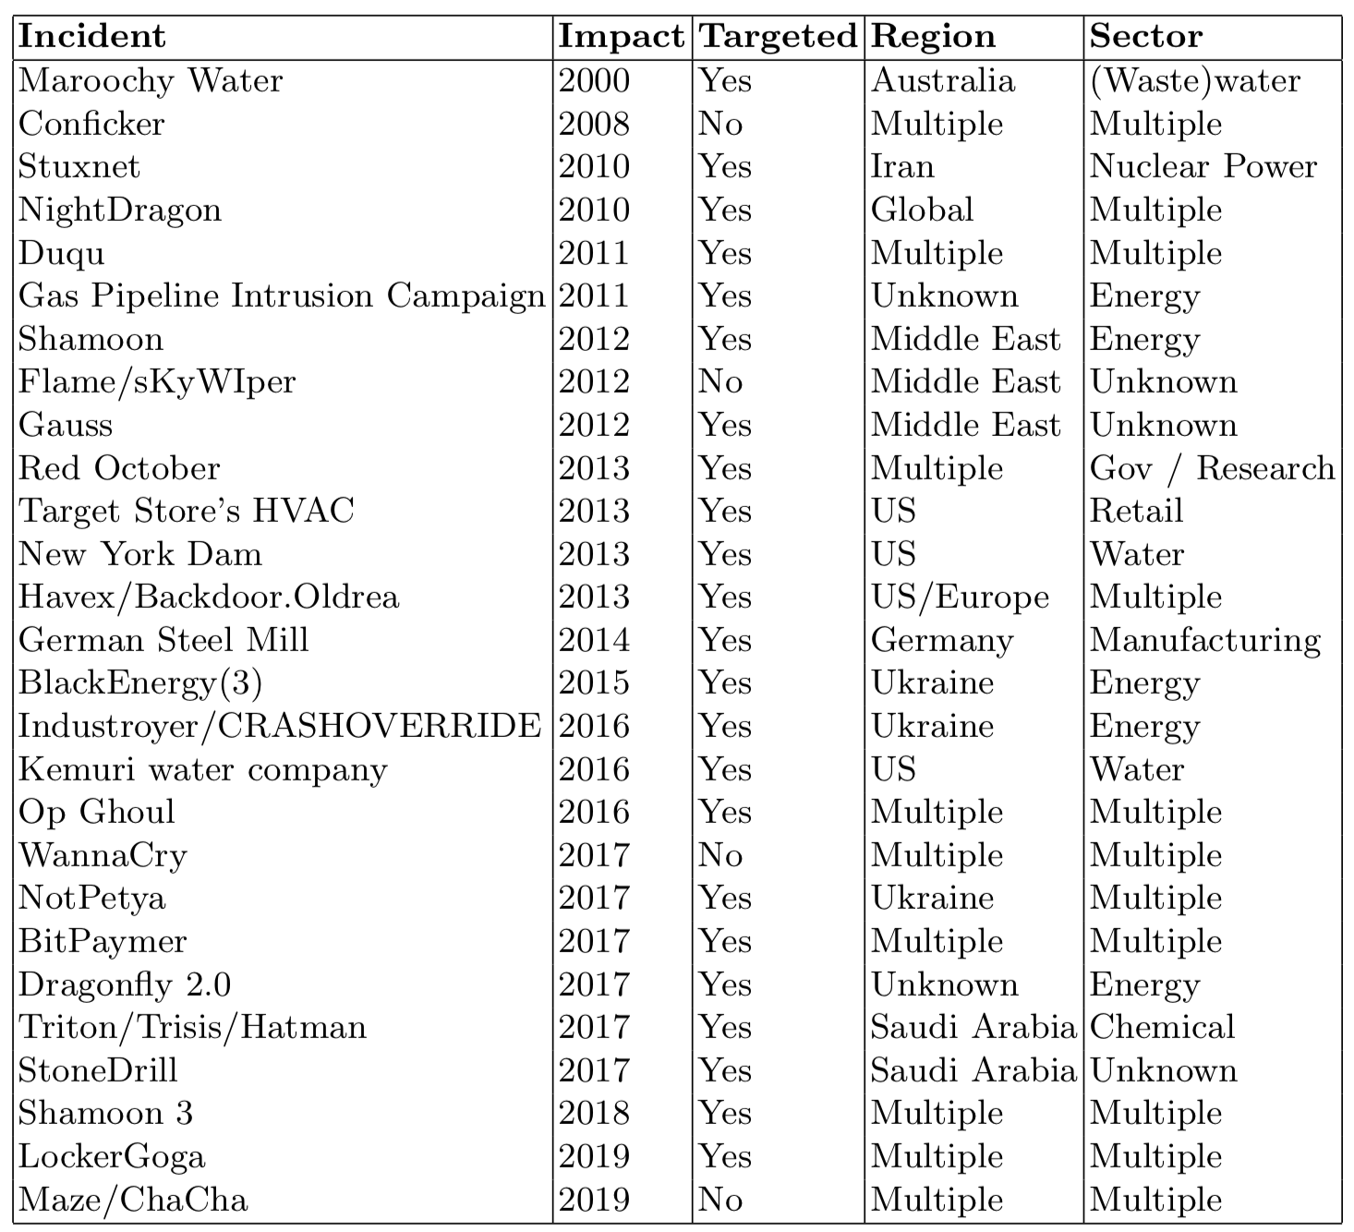
Analyzed Incidents
27
Notes:
Evtl. rausnehmen

